Slide 1
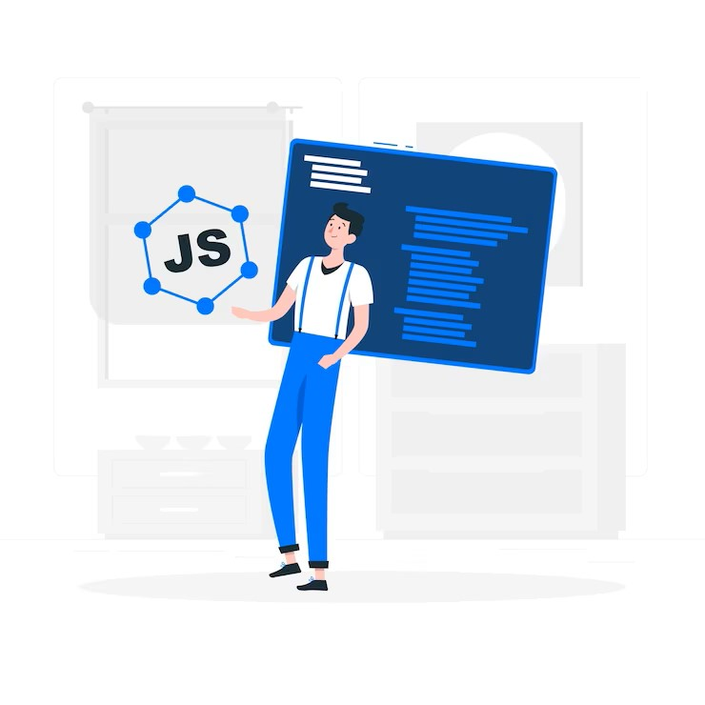

JAVASCRIPT
JAVASCRIPT BASICS

Slide 2
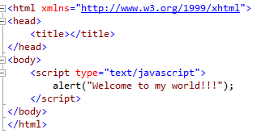
JavaScript Syntax
JavaScript consists of JavaScript statements that are placed within the <script>…</script>
<script> type="text/javascript"> and </script> tell where JavaScript starts and ends.

Slide 3


JavaScript Data Types
All numbers in JavaScript are represented as floating-point values.
JavaScript does not make a distinction between integer values and floating-point values.

Slide 4

JavaScript Variables
Variables can be thought of as named containers.
Place data into these containers and then refer to the data simply by naming the container.
Before using a variable in a JavaScript program, must declare it.
Variables are declared with the var keyword

Slide 5
JavaScript Variables
JavaScript is an untyped language.
This means that a JavaScript variable can hold a value of any data type.
Unlike many other languages, don't have to tell JavaScript during variable declaration what type of value the variable will hold.
The value type of a variable can change during the execution of a program and JavaScript takes care of it automatically.

Slide 6
JavaScript Operators
JavaScript language supports the following type of operators:
Logical (or Relational) Operators: (&&,||,!)
Comparison Operators: (==,!=,<=,>=,<,>)
Arithmetic Operators:
(+,-,/,*,%,++,--)
Conditional (or ternary) Operators: (?: )
Assignment Operators: (=,+=,-=,*=,/=)

Slide 7
Conditional Statements
JavaScript supports conditional statements which are used to perform different actions based on different conditions.
JavaScript supports the following forms of if-else statements:
Use if to specify a block of code to be executed, if a specified condition is true
Use else to specify a block of code to be executed, if the same condition is false
Use else if to specify a new condition to test, if the first condition is false
Use switch to specify many alternative blocks of code to be executed

Slide 8
JavaScript Events
JavaScript's interaction with HTML is handled through events
Events are actions.
A few examples of events:
A mouse click
The webpage loading
Mousing over a hot spot on the webpage, also known as hovering
Selecting an input box in an HTML form
A keystroke

Slide 9
JavaScript Functions
A function is a group of reusable code which can be called anywhere in the program.
Divide a big program into a number of small and manageable functions.
Before using a function we need to define that function.
Define a function in JavaScript by using the function keyword

Slide 10

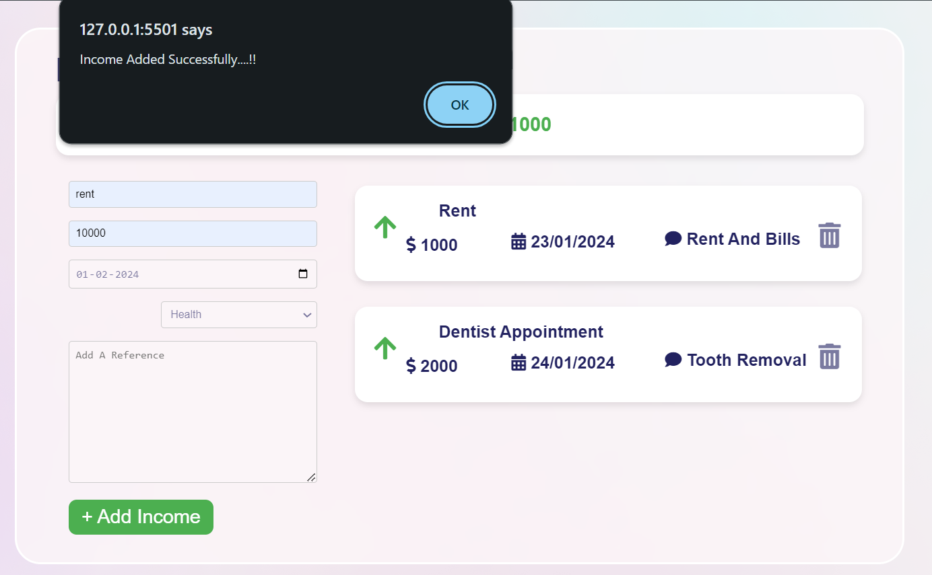
The alert() method displays an alert box with a message and an OK button.
The alert() method is used when you want information to come through to the user.

Slide 11
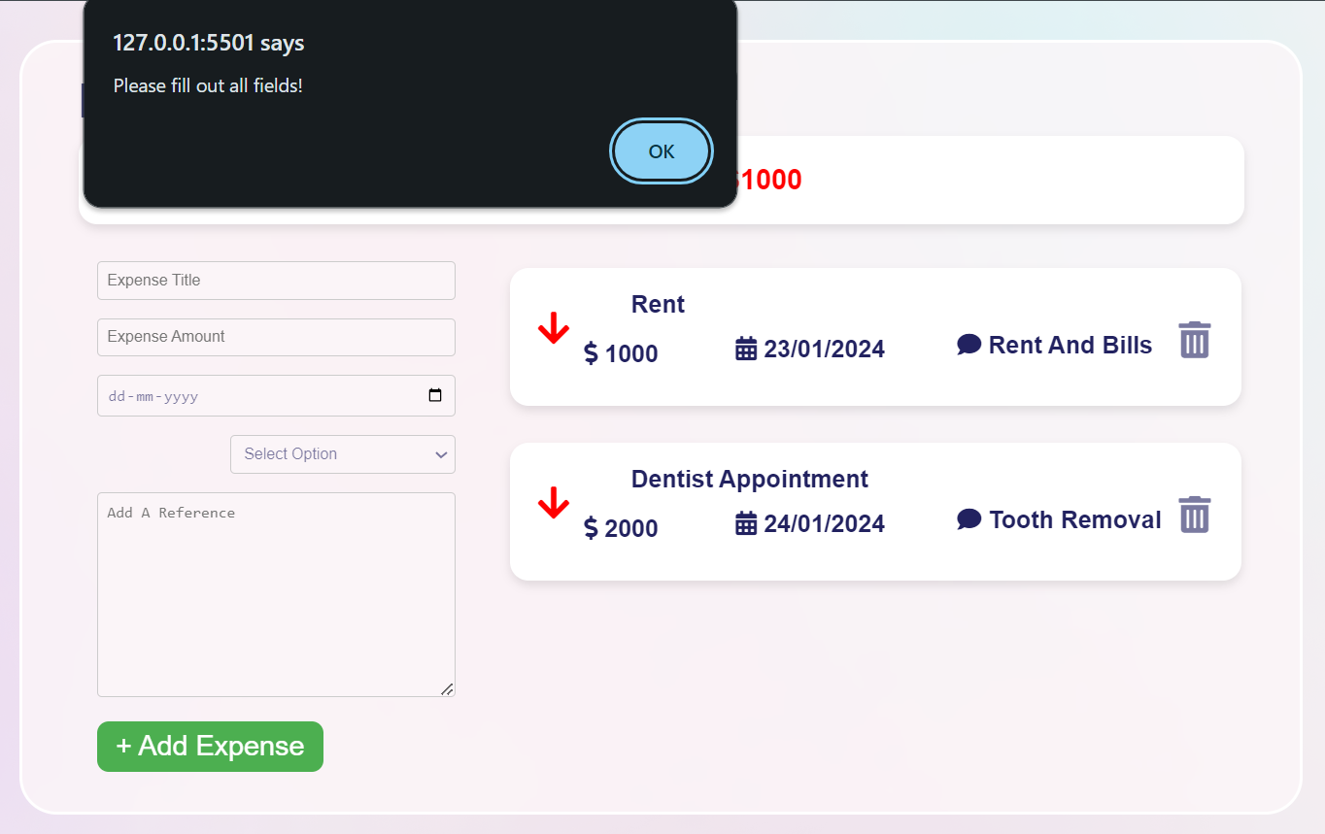
JavaScript provides facility to validate the form on the client-side so data processing will be faster than server-side validation.

Slide 12


